Slide 1
Order Management Project
Basics

Slide 2
Exchanges
Electronic trading

Slide 3
What is an exchange?
Broker 1 Customers
Buyers: 100 Sellers: 70
Broker 2 Customers
Buyers: 30 Sellers: 70
Broker 1
Imbalance: 30
Broker 2 Imbalance: -40
Exchange
Broker 3 Imbalance: -10
Broker 4 Imbalance: 20
Clearing House
Offset all imbalances at the end of the day
Broker 3 Customers
Buyers: 900 Sellers: 910
Broker 4 Customers
Buyers: 50 Sellers: 30
This chart is explained in the following slide. All connections are via FIX protocol.

Slide 4
What is an exchange?
Exchanges are companies that offers a centralized place where buyers and sellers of specific securities (financial instruments) can meet to close transactions. The mechanism of trading differs from one exchange to another, and some limits are placed on how they operate by government (law). The mechanism of trading that an exchange uses is important to investors because different mechanisms lend themselves to different trading volume limitations and pricing behaviors. Nowadays almost all exchanges in the world adopt the “Electronic Order Book” (EOB) solution to favor transactions among investors. Usually there is at least one exchange per country, possibly more than one. Securities that an exchange authorize to exchange via its trading mechanisms are called “listed” securities. Only special companies are able to interact directly with an exchange: their member also known as brokers. Those are big companies having all necessary requirements to get a “seat” (membership) in one or more exchanges. All broker customers (that could be also a physical person) sends their orders to the broker who forward that order to the exchange where the security is listed. Al this orders travel in internet (via the FIX protocol) and matched via EOB. At the end of each trading day brokers usually experience an imbalance among executed purchases and sales (of all the orders received from their customers) for each exchanged securities, but the aggregation of all brokers imbalances for each financial instrument must sum up to zero (if quantities sold are expressed with a minus sign). The process of matching all imbalances among brokers is called “clearing” and is a centralized service provided by the exchange.

Slide 5
Order Type
An order is an intent expressed by a trader (i.e. the user of our project) to buy or sell a specific amount (number of lots) of a specific security. The price depends on the type of order the trader select.
There are many kind of orders that you can place depending upon the exchange and its rule. However all exchanges must accept at least two kind of them (native orders):
Limit Orders (LMT): the trader want to buy or sell the required quantity at an expected price. If that target price is not accepted by anyone else in the market the trade is not completed and the initiated trader gives up the deal. In other words limit orders are all orders in the EOB that can be executed at the declared price or better. These orders enter in the EOB according to the price priority rule where the best price (the lowest one for purchases and the highest one for sales) is executed first. Among orders with the same price level the priority is determined by the arrival time (FIFO queuing method).
Market Orders (MKT): all orders immediately executed at the available prices in the market in the instant in whiche they are placed. Here the trader do not matter the price; he only cares about the immediate execution of the deal.
To summarize: a trader that place a limit order is not interested in an immediate execution, but is interested in the execution price. He waits until some market player accepts to enter into an exchange at the price desired by the trader. Those kind of orders «offer liquidity to markets» meaning that they provide the possibility to trade.
Market orders on the other hand are way to immediatly execute a trade no matter what the price is. MKT «consume market liquidity».

Slide 6
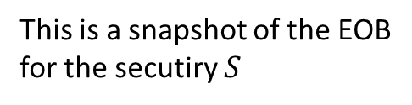
Electronic Order Book
This is a snapshot of the EOB
for the secutiry $S$
Volume | Price
56 | 1277.25
100 | 1277
435 | 1276.5
350 | 1276
500 | 1275.75
610 | 1275.5
230 | 1275.25
340 | 1275
300 | 1274.75
100 | 1274.5
Tick Value = 0.25
LIMIT ORDER
I’m available to sell at 1275.75 or better (higher price)
ASK
arrival time
50 | 70 | 120 | 40 | 110 | 110
=
You have not the luxory to see those information
in the book: only prices and aggregated volumes
LIMIT ORDER
I’m available to buy at 1275.5 or better (lower price)
BID

Slide 7
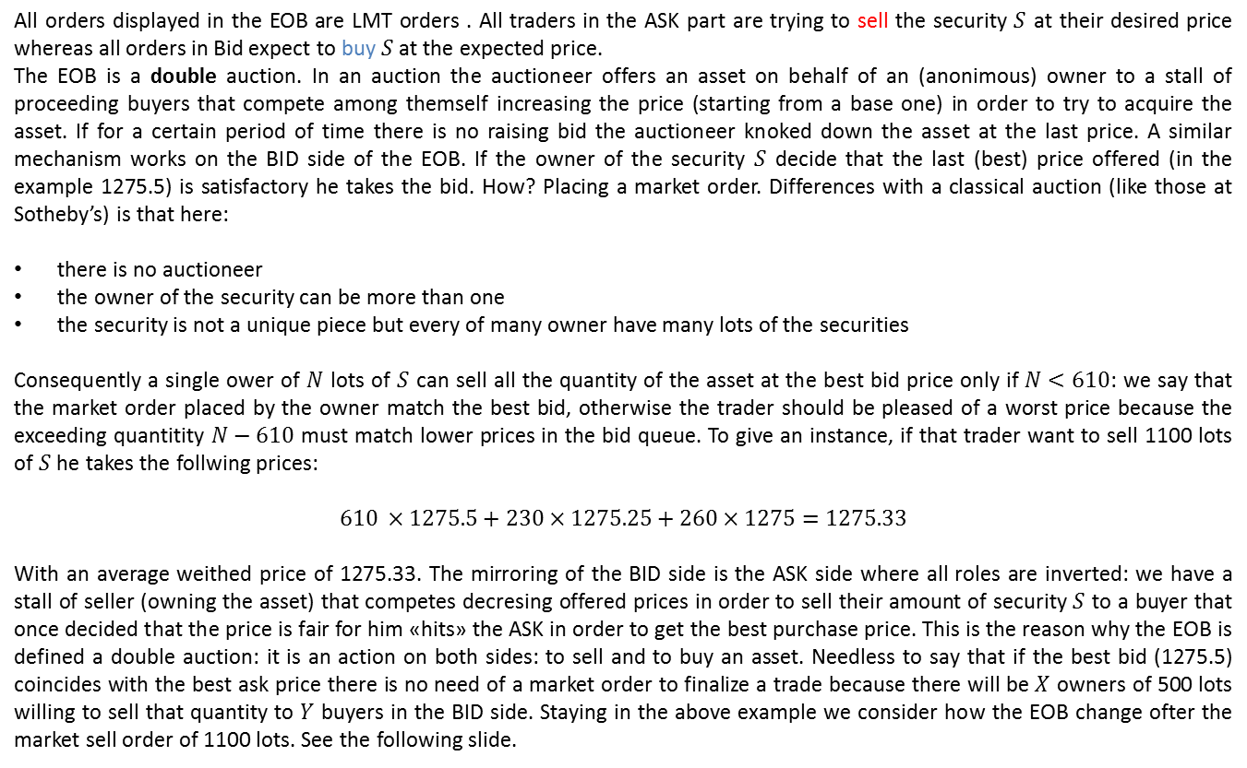
Previous slide explanation
All orders displayed in the EOB are LMT orders . All traders in the ASK part are trying to sell the security $S$ at their desired price whereas all orders in Bid expect to buy $S$ at the expected price.
The EOB is a double auction. In an auction the auctioneer offers an asset on behalf of an (anonimous) owner to a stall of proceeding buyers that compete among themself increasing the price (starting from a base one) in order to try to acquire the asset. If for a certain period of time there is no raising bid the auctioneer knoked down the asset at the last price. A similar mechanism works on the BID side of the EOB. If the owner of the security $S$ decide that the last (best) price offered (in the example 1275.5) is satisfactory he takes the bid. How? Placing a market order. Differences with a classical auction (like those at Sotheby’s) is that here:
there is no auctioneer
the owner of the security can be more than one
the security is not a unique piece but every of many owner have many lots of the securities
Consequently a single ower of $N$ lots of $S$ can sell all the quantity of the asset at the best bid price only if $N<610$: we say that the market order placed by the owner match the best bid, otherwise the trader should be pleased of a worst price because the exceeding quantitity $N−610$ must match lower prices in the bid queue. To give an instance, if that trader want to sell 1100 lots of $S$ he takes the follwing prices:
$$610 ×1275.5+230×1275.25+260×1275=1275.33$$
With an average weithed price of 1275.33. The mirroring of the BID side is the ASK side where all roles are inverted: we have a stall of seller (owning the asset) that competes decresing offered prices in order to sell their amount of security $S$ to a buyer that once decided that the price is fair for him «hits» the ASK in order to get the best purchase price. This is the reason why the EOB is defined a double auction: it is an action on both sides: to sell and to buy an asset. Needless to say that if the best bid (1275.5) coincides with the best ask price there is no need of a market order to finalize a trade because there will be $X$ owners of 500 lots willing to sell that quantity to $Y$ buyers in the BID side. Staying in the above example we consider how the EOB change ofter the market sell order of 1100 lots. See the following slide.

Slide 8
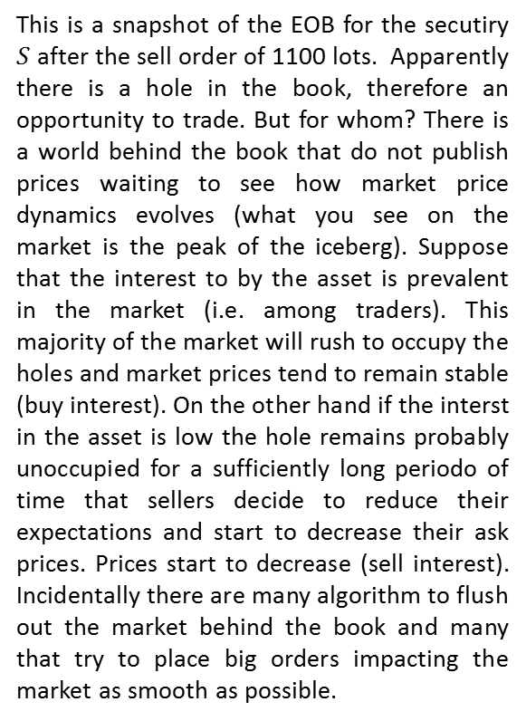
New incoming orders
Volume | Price
56 | 1277.25
100 | 1277
435 | 1276.5
350 | 1276
500 | 1275.75
260 | 1275
300 | 1274.75
100 | 1274.5
Tick Value = 0.25
This is a snapshot of the EOB for the secutiry $S$ after the sell order of 1100 lots. Apparently there is a hole in the book, therefore an opportunity to trade. But for whom? There is a world behind the book that do not publish prices waiting to see how market price dynamics evolves (what you see on the market is the peak of the iceberg). Suppose that the interest to by the asset is prevalent in the market (i.e. among traders). This majority of the market will rush to occupy the holes and market prices tend to remain stable (buy interest). On the other hand if the interst in the asset is low the hole remains probably unoccupied for a sufficiently long periodo of time that sellers decide to reduce their expectations and start to decrease their ask prices. Prices start to decrease (sell interest). Incidentally there are many algorithm to flush out the market behind the book and many that try to place big orders impacting the market as smooth as possible.
ASK
hole
BID

Slide 9
Two scenarios
Volume | Price
56 | 1277.25
100 | 1277
435 | 1276.5
350 | 1276
500 | 1275.75
1020 | 1275.5
450 | 1275.25
260 | 1275
300 | 1274.75
100 | 1274.5
New incoming orders
Volume | Price
56 | 1277.25
100 | 1277
435 | 1276.5
350 | 1276
500 | 1275.75
450 | 1275.5
240 | 1275.25
260 | 1275
300 | 1274.75
100 | 1274.5
ASK
ASK
hole
hole
BID
BID
Buy interest
Sell interest

Slide 10
Over-The-Counter
Transaction can occurs also in a decentralized way called Over-The-Counter (OTC). There is no exchange but some big companies (usually banks) that works as dealers to allow the exchange of some financial instruments.
Dealer markets — traditionally — operate a little differently than auction markets. Instead of matching buyers' bids with sellers' asking prices, orders are placed directly with dealers of shares, who offer quotes to purchasers and sellers. Quotes are usually "take it or leave it“. Each dealer can offer its own EOB to traders, but usually dealers enters into agreements to provide for a consolidated EOB to traders. From the trader point of view the two systems (exchanges and OTC) looks very similar because all transactions are performed in a EOB, but from a regulation side both solutions are very different.
Needless to say that all communications among traders and dealers occurs via FIX protocol.

Slide 11
Financial instruments
Bonds, Stocks and Derivatives

Slide 12
Equities
A stock also known as “equity” or “share” is a type of security that signifies ownership in a corporation and represents a claim on part of the corporation's assets and earnings.
There are two main types of stock: common and preferred. Common stock usually entitles the owner to vote at shareholders' meetings and to receive dividends. Preferred stock generally does not have voting rights, but has a higher claim on assets and earnings than the common shares. For example, owners of preferred stock receive dividends before common shareholders and have priority in the event that a company goes bankrupt and is liquidated. The stock has no expiration and lives as long as the issuing company live. During their life they can bear some events like the listing in an exchange (in that project we consider only listed stocks) or splitting (e.g. withdraw all shares and issue two new shares for each old one called in halving their price of course).
A holder of stock (a shareholder) has a claim to a part of the corporation's assets and earnings. In other words, a shareholder is an owner of a company. Ownership is determined by the number of shares a person owns relative to the number of outstanding shares. For example, if a company has 1,000 shares of stock outstanding and one person owns 100 shares, that person would own and have claim to 10% of the company's assets.

Slide 13
Bonds
A bond is a debt investment in which an investor loans money to an entity (typically corporate or governmental) which borrows the funds for a defined period of time at a variable or fixed interest rate. Bonds are used by companies, municipalities, states and sovereign governments to raise money and finance a variety of projects and activities. Owners of bonds are debtholders, or creditors, of the issuer.
Bonds are commonly referred to as fixed-income securities and are one of the three main generic asset classes, along with stocks (equities) and cash equivalents. Many corporate and government bonds are publicly traded on exchanges, while others are traded only over-the-counter (OTC).
When companies or other entities need to raise money to finance new projects, maintain ongoing operations, or refinance existing other debts, they may issue bonds directly to investors instead of obtaining loans from a bank. The indebted entity (issuer) issues a bond that contractually states the interest rate (coupon) that will be paid and the time at which the loaned funds (bond principal) must be returned (maturity date).
Most bonds share some common basic characteristics including:
Face value is the money amount the bond will be worth at its maturity, and is also the reference amount the bond issuer uses when calculating interest payments.
Coupon rate is the rate of interest the bond issuer will pay on the face value of the bond, expressed as a percentage.
Coupon dates are the dates on which the bond issuer will make interest payments. Typical intervals are annual or semi-annual coupon payments.
Maturity date is the date on which the bond will mature and the bond issuer will pay the bond holder the face value of the bond.
Issue price is the price at which the bond issuer originally sells the bonds.

Slide 14
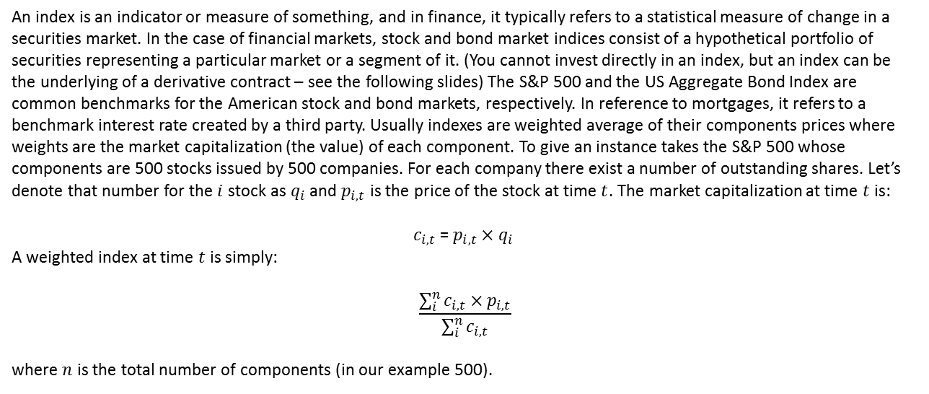
Indeces
An index is an indicator or measure of something, and in finance, it typically refers to a statistical measure of change in a securities market. In the case of financial markets, stock and bond market indices consist of a hypothetical portfolio of securities representing a particular market or a segment of it. (You cannot invest directly in an index, but an index can be the underlying of a derivative contract – see the following slides) The S&P 500 and the US Aggregate Bond Index are common benchmarks for the American stock and bond markets, respectively. In reference to mortgages, it refers to a benchmark interest rate created by a third party. Usually indexes are weighted average of their components prices where weights are the market capitalization (the value) of each component. To give an instance takes the S&P 500 whose components are 500 stocks issued by 500 companies. For each company there exist a number of outstanding shares. Let’s denote that number for the $i$ stock as $q_{i}$ and $p_{i,t}$ is the price of the stock at time $t$. The market capitalization at time $t$ is:
$c_{i,t}$ = $p_{i,t}×q_{i }$
A weighted index at time $t$is simply:
$$\frac{\sum_{i}^{n}{c_{i,t}×p_{i,t}}}{\sum_{i}^{n}{c_{i,t}}}$$
where $n$ is the total number of components (in our example 500).

Slide 15
Currencies
Currency is a generally accepted form of money, including coins and paper notes, which is issued by a government and circulated within an economy. Used as a medium of exchange for goods and services, currency is the basis for trade.
Generally speaking, each country has its own currency. For example, Switzerland's official currency is the Swiss franc, and Japan's official currency is the yen. An exception would be the euro, which is used as the currency for several European countries. While these currencies can be specific to a nation, other countries have declared foreign currency to be legal tender in their own country. For example, El Salvador and Panama allow the use of the U.S. dollar as legal tender, and immediately after the founding of the U.S. mint in 1792, U.S. residents used Spanish coins because they were heavier.
Some currencies, like cryptocurrencies​, bitcoin​, dogecoin and other online currencies and branded currencies are not tied to any country. Branded currencies, like airline and credit card points, or in-game credits are valued in relationship to the value of the products or services they’re tied to. Control over digital currencies is entirely decentralized, and the exchange rate of a digital currency can vary widely in a short period of time. Investors often trade currency on the foreign exchange market, which is one of the most heavily traded markets in the world. An exchange rate is the rate at which two currencies can be exchanged against each other.

Slide 16
Futures
Futures are financial contracts obligating the buyer to purchase an asset or the seller to sell an asset, such as a physical commodity or a financial instrument (underlying), at a predetermined future date (the expiration date) and price. The price of each future contract “derives” from the price of the underlying (this is the reason why it is classified as derivative in financial lingo). The underlying could also be a non-tradable asset like an index.
Futures contracts detail the quality (e.g. the quality of the wheat that is the underlying) and quantity (e.g. how many kilograms, actually bushel of wheat to exchange) of the underlying asset; they are standardized to facilitate trading on a futures exchange. Some futures contracts may call for physical delivery of the asset (nearly all futures whose underlying is a commodity), while others are settled in cash (e.g. the future on S&P 500 index). Besides the expiration date each future contract must have an issuing date. Therefore those are financial instruments that live for a periods (few months) and not forever like equities. Futures entailing a physical delivery of the underlying has also a third important date: the first notice date that usually precedes the expiration dates. From that date on the owner of a future contract can claim the underlying and those one that sold a future contracts are obliged to deliver the underlying. Futures are issued by the exchanges in which they are listed that determines all their features (e.g. expiration dates, the quality of the underlying, etc.).
Futures contracts are used to manage potential movements in the prices of the underlying assets. If market participants anticipate an increase in the price of an underlying asset in the future, they could potentially gain by purchasing the asset in a futures contract and selling it later at a higher price on the spot market or profiting from the favorable price difference through cash settlement. However, they could also lose if an asset's price is eventually lower than the purchase price specified in the futures contract. Conversely, if the price of an underlying asset is expected to fall, some may sell the asset in a futures contract (even without owing it) and buy it back later at a lower price on the spot market, i.e. the market of the underlying (short selling). However originally futures were invented to hedge against future underlying price changes. For instance a refinery would like to protect against oil price swing that is the raw material of the cracking process. For that goal the refinery can use future contracts. To hedge, someone is in the business of actually using or producing the underlying asset in a futures contract. When there is a gain from the futures contract, there is always a loss from the spot market, or vice versa. With such a gain and loss offsetting each other, the hedging effectively locks in the acceptable, current market price.

Slide 17
Options
An option is a financial derivative that represents a contract sold by one party (the option writer) to another party (the option holder). The contract offers the buyer the right, but not the obligation, to buy (call) or sell (put) a security or other financial asset (the underlying) at an agreed-upon price (the strike price) during a certain period of time or on a specific date (exercise date). Like any other derivative also options “derive” their prices (premiums) from the price of their underlying. Traders use options to speculate, while hedgers use options to reduce the risk of holding the underlying asset. Hedging stems from the fact that the option buyer pays a premium (the option price) to protect against the underlying price movements (up or down). According to that view purchasing an option is equivalent to purchase an insurance. Options have – like futures – an issuing date and an expiring date (but not a first notice date).
Call Option
Call options give the option to buy the underlying at certain price (the strike), so the buyer would want the underlying price to go up. Conversely, the option writer needs to provide the underlying in the event that the its market price exceeds the strike due to the contractual obligation. An option writer who sells a call option believes that the underlying price will drop relative to the option's strike price during the life of the option, as that is how he will reap maximum profit.
This is exactly the opposite outlook of the option buyer. The buyer believes that the underlying price will rise; if this happens, the buyer will be able to acquire the underlying for a lower price (the strike price) and then sell it for a profit. However, if the underlying price does not close above the strike price on the expiration date, the option buyer would lose the premium (option price) paid for the call option.
Put Option
Put options give the option to sell the underlying at a certain price (the strike), so the buyer would want the underlying price to go down. The opposite is true for put option writers. For example, a put option buyer is pessimistic on the underlying and believes its market price will fall below the specified strike price on or before a specified date. On the other hand, an option writer who shorts a put option believes the underlying's price will increase about a specified price on or before the expiration date.
If the underlying’s price closes above the specified strike price on the expiration date, the put option writer's maximum profit is achieved. Conversely, a put option holder would only benefit from a fall in the underlying’s price below the strike price. If the underlying’s price falls below the strike price, the put option writer is obligated to purchase the underlying at the strike price.

Slide 18
References
For exchanges functioning and general finalcial market architecture:
Ruben Lee - What is an Exchange? Automation, Management, and Regulation
of Financial Markets (1998)
For financial instruments (securities) with particular focus on derivatives:
John Hull - Options, futures and other derivatives (8th edition)
in particular Chapters 1, 2, 9.
But I suggest to visit https://www.investopedia.com for a quick definition of all
concepts in those slides.

